Slide 1
Morphological Operations
Activity 8 Short Report
Lou Josef S. Tan

Slide 2
Tasks
Basic Morphological Operations
Erosion of pixels
Dilation of pixels

Slide 3

Basic Morphological Operations
Definitions - Erosion
Given some shape A and a structuring element B, erosion aims to reduce A by the shape of B. Mathematically speaking, this operation is denoted by:
Equation 1 says that erosion is the set of all points z such that B translated by z is contained in A^{[1]}.
(1)
[1] – Soriano, M. (2019). A8 – Morphological Operations [lecture handouts]

Slide 4
Basic Morphological Operations
Definitions - Erosion
To visualize this, say we have our structure element as in Fig. 1 with its origin marked by the black dot. We run this along our shape, making sure that the structure element is within the shape, and then we map the origin along all pixels it traverses. Those mapped dots constitute our eroded shape.
Figure 1. Erosion operation

Slide 5

Basic Morphological Operations
Definitions - Dilation
Given some shape A and a structuring element B, dilation aims to expand A in the shape of B. Mathematically speaking, this operation is denoted by:
Equation 2 says that dilation involves all z’s that are translation of a reflected B that when intersected with A is not the empty set^{[1]}.
(2)
[1] – Soriano, M. (2019). A8 – Morphological Operations [lecture handouts]

Slide 6
Basic Morphological Operations
Definitions - Erosion
To visualize this, say we have our structure element as in Fig. 2 with its origin marked by the black dot. We run the black dot along our shape (with the SE), and then retain all outlying pixels that are not originally in the shape. These constitute our dilated shape.
Figure 2. Dilation operation

Slide 7
Basic Morphological Operations
Preliminaries
Four shapes (5x5 square, triangle, 10x10 hollow square, plus sign), and five structure elements (2x2, 2x1, 1x2 ones, 3-pixel long cross, diagonal) were drawn on a graphing paper. Resulting images from erosion and dilation were predicted. The drawings are shown in the next few slides.

Slide 8
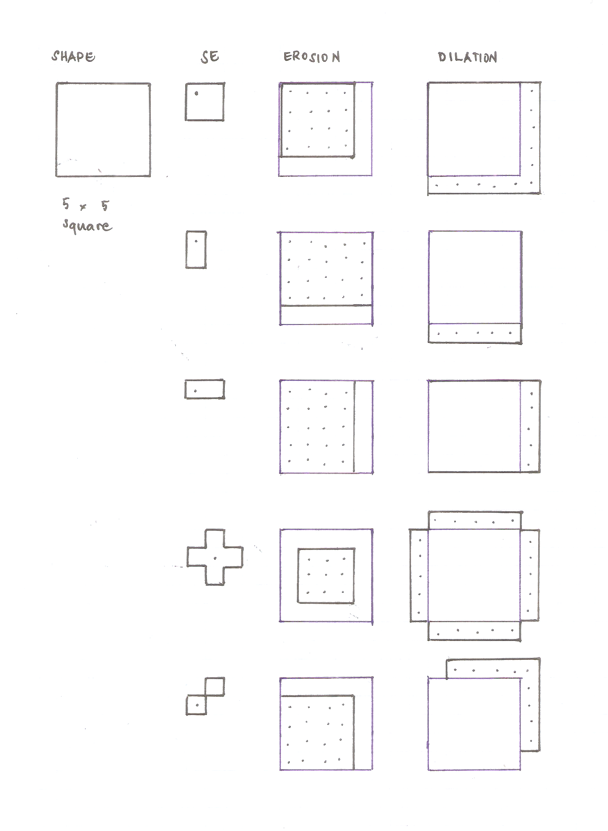
Basic Morphological Operations
Preliminaries
Figure 3. Predicted erosion and dilation for 5x5 square. Blue ink denotes the original shape, dots in erosion constitute eroded shape, dots in dilation constitute the additional pixels to be added to the dilated shape.

Slide 9
Basic Morphological Operations
Preliminaries
Figure 3. Predicted erosion and dilation for 5x5 square. Blue ink denotes the original shape, dots in erosion constitute eroded shape, dots in dilation constitute the additional pixels to be added to the dilated shape.

Slide 10
Basic Morphological Operations
Preliminaries
Figure 3. Predicted erosion and dilation for 5x5 square. Blue ink denotes the original shape, dots in erosion constitute eroded shape, dots in dilation constitute the additional pixels to be added to the dilated shape.

Slide 11
Basic Morphological Operations
Preliminaries
Figure 3. Predicted erosion and dilation for 5x5 square. Blue ink denotes the original shape, dots in erosion constitute eroded shape, dots in dilation constitute the additional pixels to be added to the dilated shape.

Slide 12
Basic Morphological Operations
Preliminaries
Figure 3. Predicted erosion and dilation for 5x5 square. Blue ink denotes the original shape, dots in erosion constitute eroded shape, dots in dilation constitute the additional pixels to be added to the dilated shape.

Slide 13
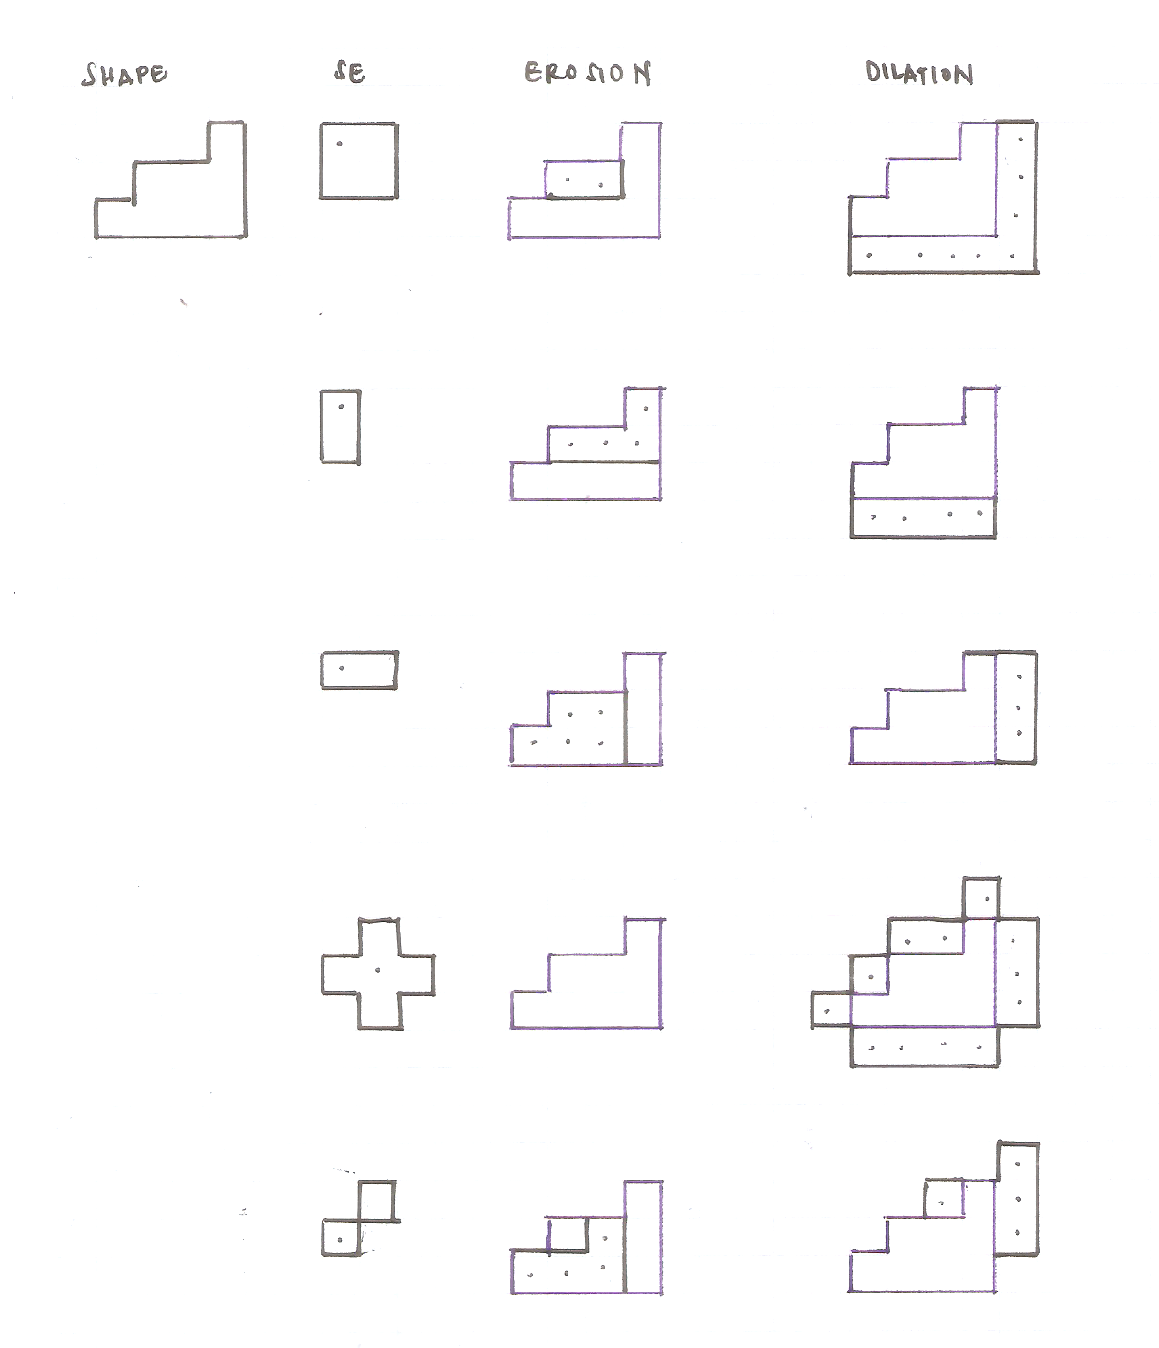
Basic Morphological Operations
Preliminaries
Figure 4. Predicted erosion and dilation for triangle (4-box base, 3-box height). Blue ink denotes the original shape, dots in erosion constitute eroded shape, dots in dilation constitute the additional pixels to be added to the dilated shape.

Slide 14
Basic Morphological Operations
Preliminaries
Figure 4. Predicted erosion and dilation for triangle (4-box base, 3-box height). Blue ink denotes the original shape, dots in erosion constitute eroded shape, dots in dilation constitute the additional pixels to be added to the dilated shape.

Slide 15
Basic Morphological Operations
Preliminaries
Figure 4. Predicted erosion and dilation for triangle (4-box base, 3-box height). Blue ink denotes the original shape, dots in erosion constitute eroded shape, dots in dilation constitute the additional pixels to be added to the dilated shape.

Slide 16
Basic Morphological Operations
Preliminaries
Figure 4. Predicted erosion and dilation for triangle (4-box base, 3-box height). Blue ink denotes the original shape, dots in erosion constitute eroded shape, dots in dilation constitute the additional pixels to be added to the dilated shape.

Slide 17
Basic Morphological Operations
Preliminaries
Figure 4. Predicted erosion and dilation for triangle (4-box base, 3-box height). Blue ink denotes the original shape, dots in erosion constitute eroded shape, dots in dilation constitute the additional pixels to be added to the dilated shape.

Slide 18
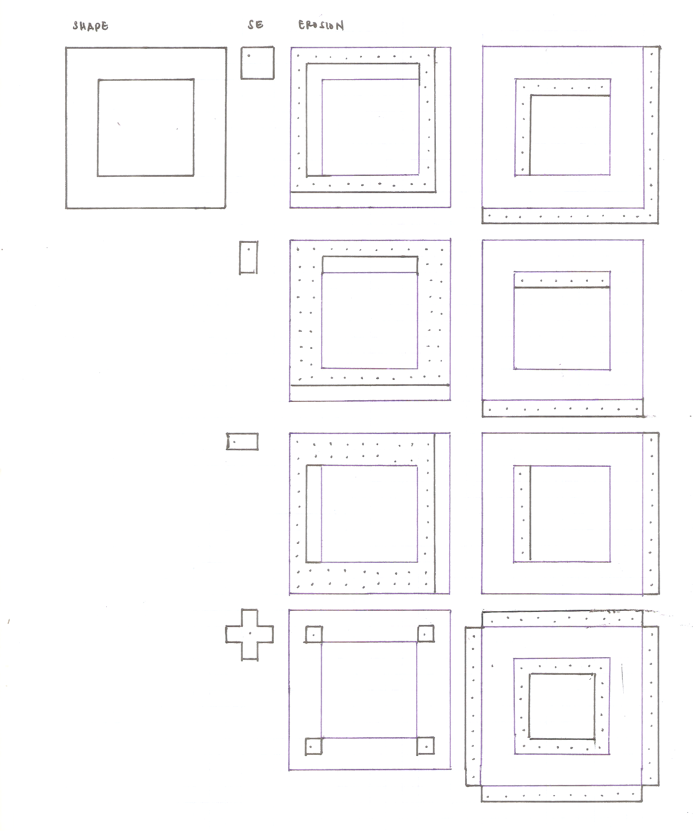
Basic Morphological Operations
Preliminaries
Figure 5. Predicted erosion and dilation for 10x10 hollow square. Blue ink denotes the original shape, dots in erosion constitute eroded shape, dots in dilation constitute the additional pixels to be added to the dilated shape.

Slide 19
Basic Morphological Operations
Preliminaries
Figure 5. Predicted erosion and dilation for 10x10 hollow square. Blue ink denotes the original shape, dots in erosion constitute eroded shape, dots in dilation constitute the additional pixels to be added to the dilated shape.

Slide 20
Basic Morphological Operations
Preliminaries
Figure 5. Predicted erosion and dilation for 10x10 hollow square. Blue ink denotes the original shape, dots in erosion constitute eroded shape, dots in dilation constitute the additional pixels to be added to the dilated shape.

Slide 21
Basic Morphological Operations
Preliminaries
Figure 5. Predicted erosion and dilation for 10x10 hollow square. Blue ink denotes the original shape, dots in erosion constitute eroded shape, dots in dilation constitute the additional pixels to be added to the dilated shape.

Slide 22
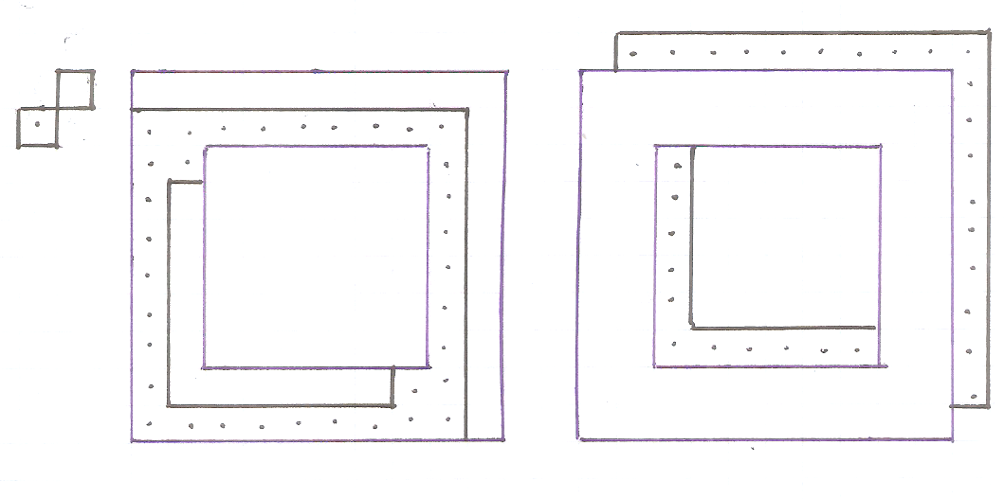
Basic Morphological Operations
Preliminaries
Figure 5. Predicted erosion and dilation for 10x10 hollow square. Blue ink denotes the original shape, dots in erosion constitute eroded shape, dots in dilation constitute the additional pixels to be added to the dilated shape.

Slide 23
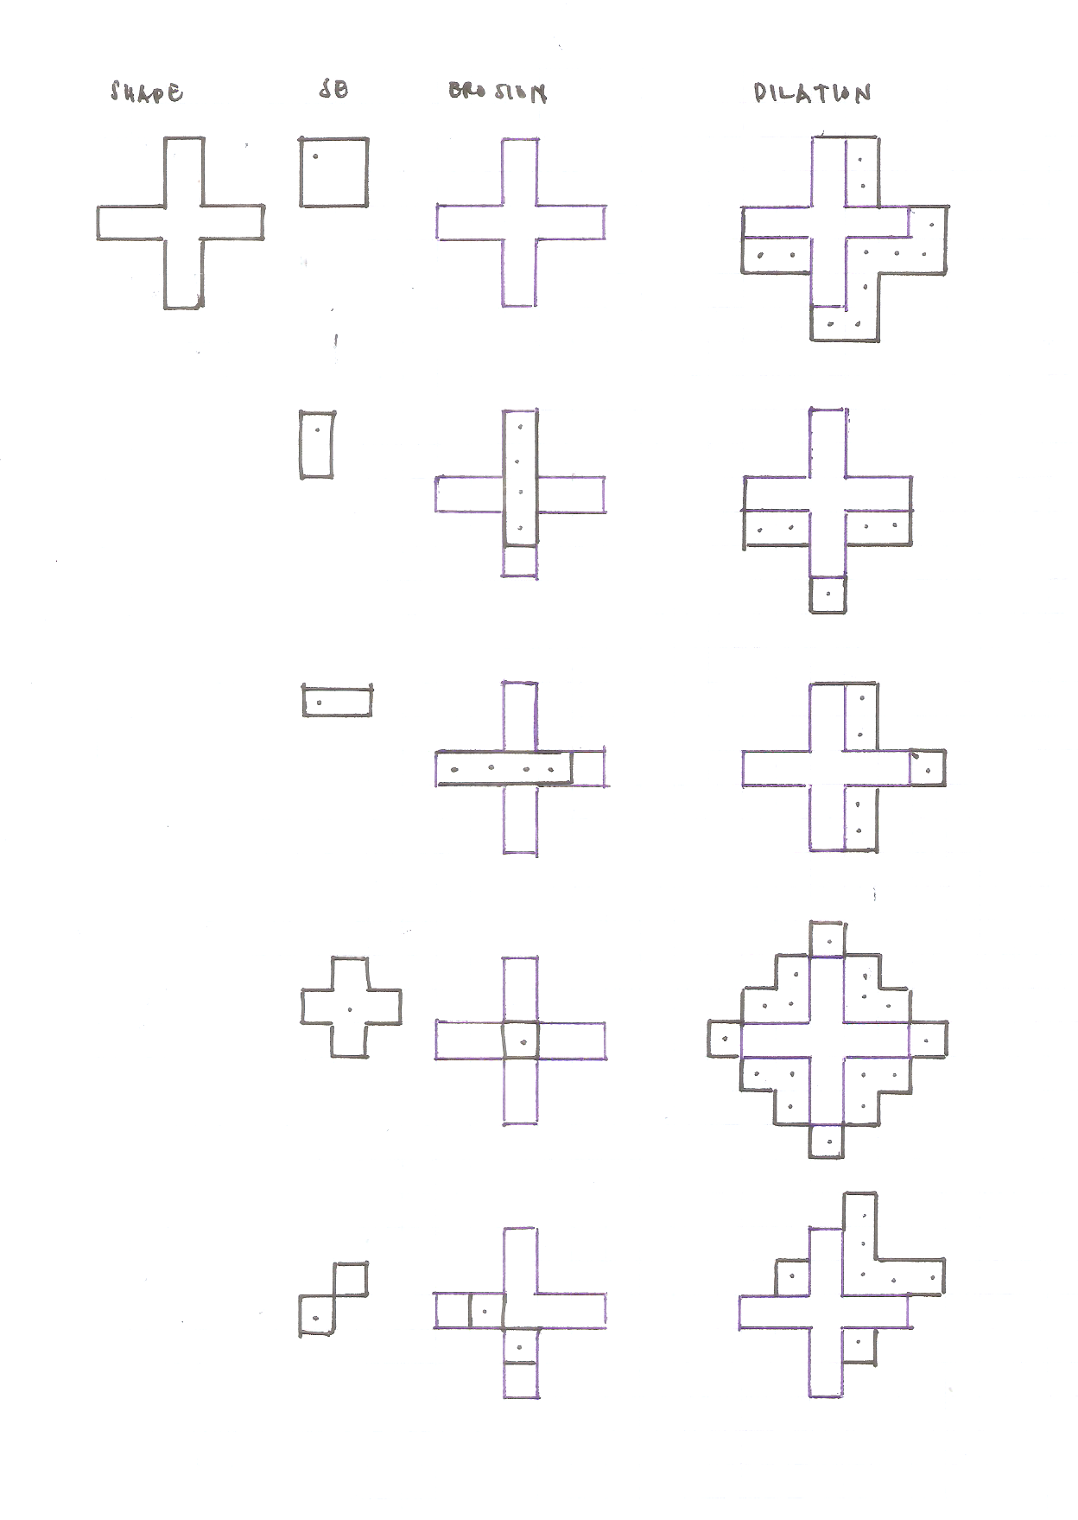
Basic Morphological Operations
Preliminaries
Figure 6. Predicted erosion and dilation for 5-box long plus sign. Blue ink denotes the original shape, dots in erosion constitute eroded shape, dots in dilation constitute the additional pixels to be added to the dilated shape.

Slide 24
Basic Morphological Operations
Preliminaries
Figure 6. Predicted erosion and dilation for 5-box long plus sign. Blue ink denotes the original shape, dots in erosion constitute eroded shape, dots in dilation constitute the additional pixels to be added to the dilated shape.

Slide 25
Basic Morphological Operations
Preliminaries
Figure 6. Predicted erosion and dilation for 5-box long plus sign. Blue ink denotes the original shape, dots in erosion constitute eroded shape, dots in dilation constitute the additional pixels to be added to the dilated shape.

Slide 26
Basic Morphological Operations
Preliminaries
Figure 6. Predicted erosion and dilation for 5-box long plus sign. Blue ink denotes the original shape, dots in erosion constitute eroded shape, dots in dilation constitute the additional pixels to be added to the dilated shape.

Slide 27
Basic Morphological Operations
Preliminaries
Figure 6. Predicted erosion and dilation for 5-box long plus sign. Blue ink denotes the original shape, dots in erosion constitute eroded shape, dots in dilation constitute the additional pixels to be added to the dilated shape.

Slide 28
Basic Morphological Operations
Preliminaries
Figure 6. Predicted erosion and dilation for 5-box long plus sign. Blue ink denotes the original shape, dots in erosion constitute eroded shape, dots in dilation constitute the additional pixels to be added to the dilated shape.

Slide 29
Basic Morphological Operations
Simulation
These drawings were then created in Matlab as binary images. To verify if I predicted the results correctly, erosion and dilation was also done in Matlab. In the following slides, I will be comparing the results.

Slide 30
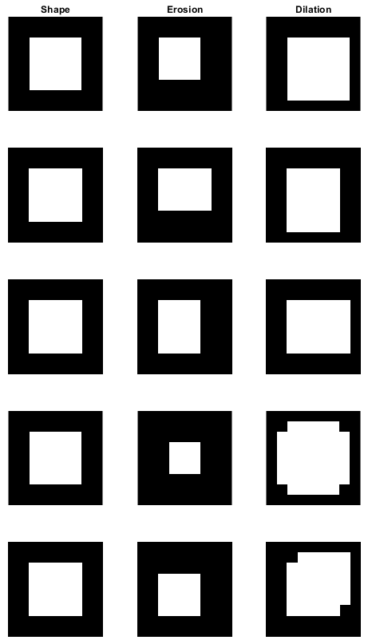
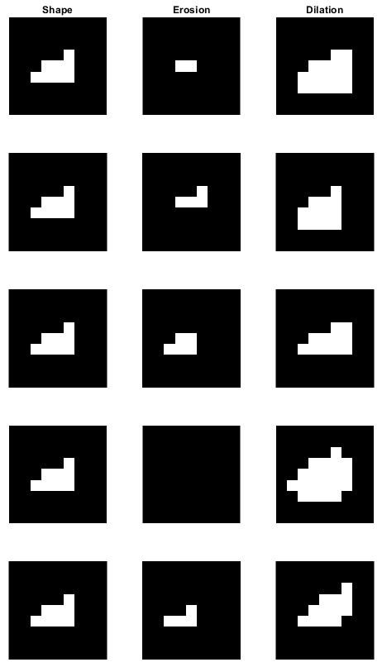
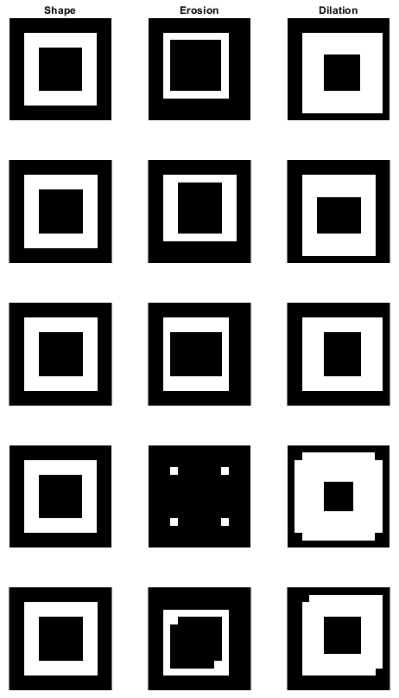
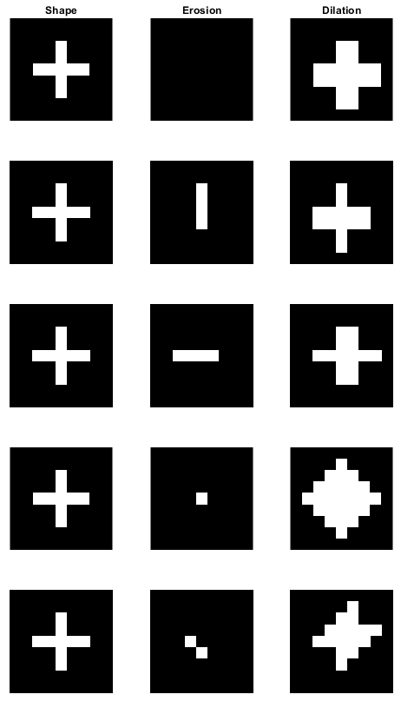
Basic Morphological Operations
Simulation
Figure 7. Morphological operations on: (L to R) 5x5 square, triangle, 10x10 hollow square, 5-pixel long plus sign.

Slide 31
Evaluation
I rate myself 10/10 for this activity for producing all required outputs.

